Slide 1
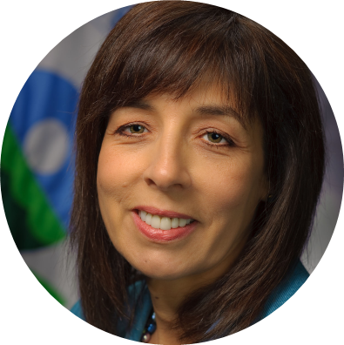
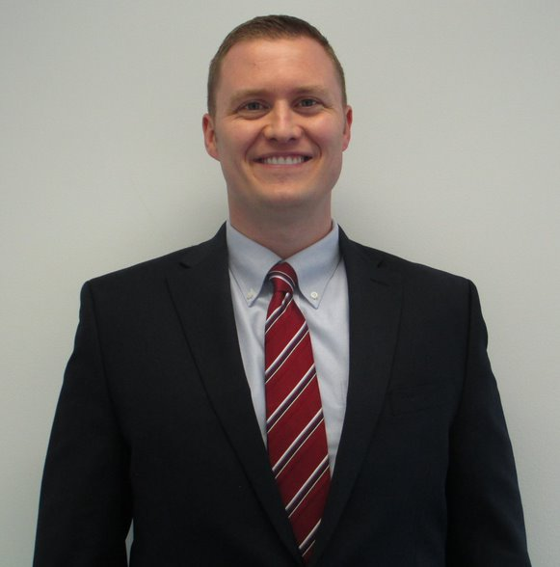
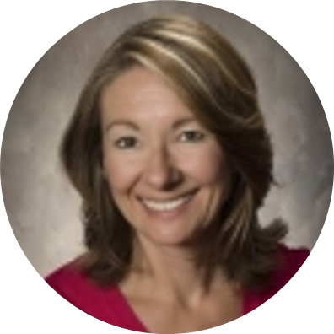
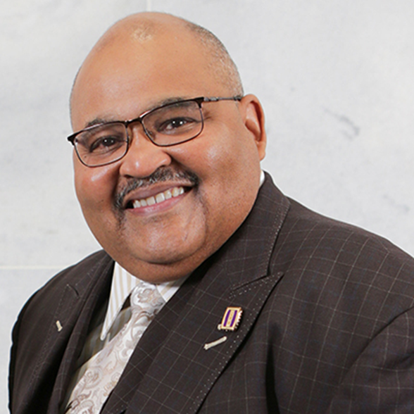
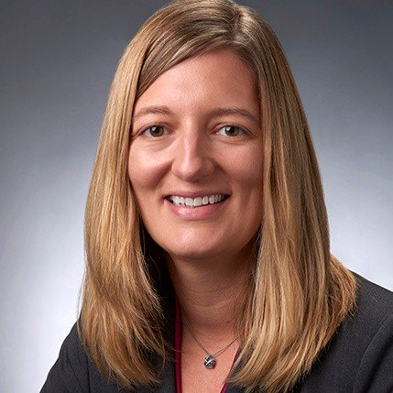
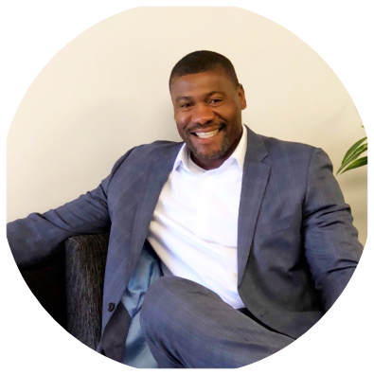
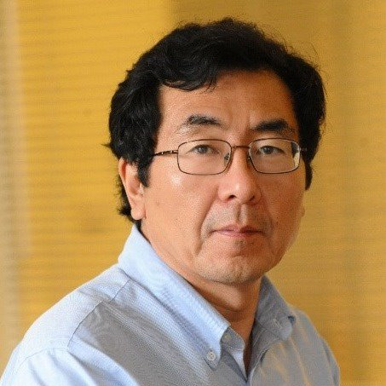
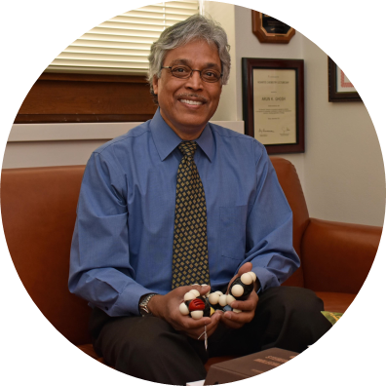
Maria J. Doa (PhD 1985)
Jeremy Walker (PhD 2006)
Diana (Berg) Gerbi (BS 1975)
McMahan L. Gray (BS 1980)
Jamie (McCabe) Dunn (PhD 2007)
Monde Qhobosheane (BS 1997)
Jingguang Chen (PhD 1988)
Arun Ghosh (PhD 1985)

